Slide 1
9. Administer Azure PaaS Compute

Slide 2




Administer PaaS Compute Options Introduction
Configure Azure App Service Plans
Configure Azure App Services
Configure Azure Container Instances
Configure Azure Kubernetes Service
Lab 09a - Implement Web Apps
Lab 09b - Implement Azure Container Instances
Lab 09c - Implement Azure Kubernetes Service (optional)
Notes:
These Learn modules are part of the AZ-104: Deploy and manage Azure compute resources (https://docs.microsoft.com/learn/paths/az-104-manage-compute-resources/) learning path.

Slide 3
Configure Azure App Service Plans

Slide 4
Before Getting into App Service Plans (ASPs) ..
Web Applications need Web Servers before they can be accessed.
Linux/Windows OpenSource Web Servers: Apache Tomcat, Nginx, etc.
Nginx is beta version on Windows
Native Windows Web Server: Internet Information Services (IIS)
Multiple Web Applications can be hosted on a single webserver
There are two ways a web servers can send the request to a specific web application:
Each web application is hosted on a different port, OR
Each web application has a different host address (host header)
Notes:
App Service pricing - https://azure.microsoft.com/pricing/details/app-service/windows/

Slide 5
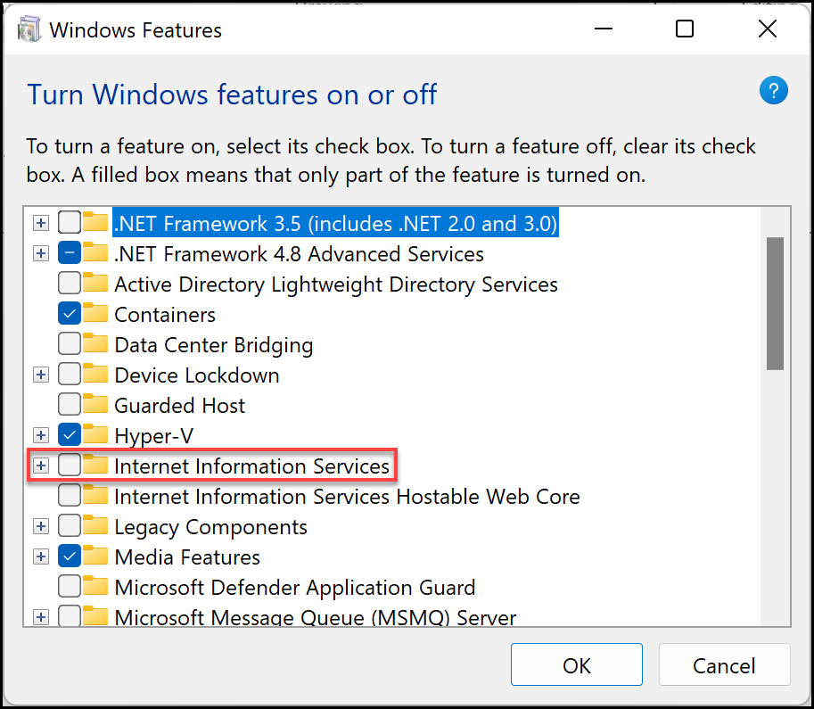
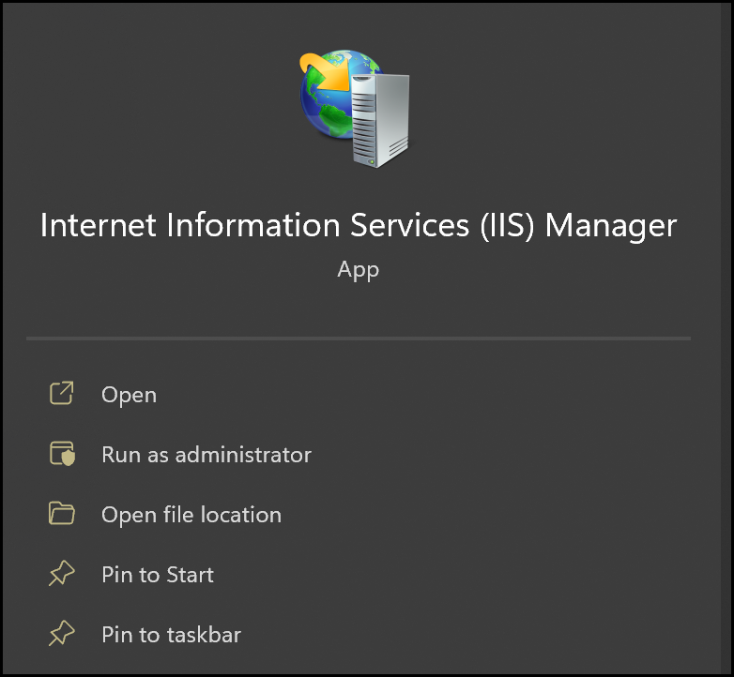
Installing IIS on Windows

Slide 6
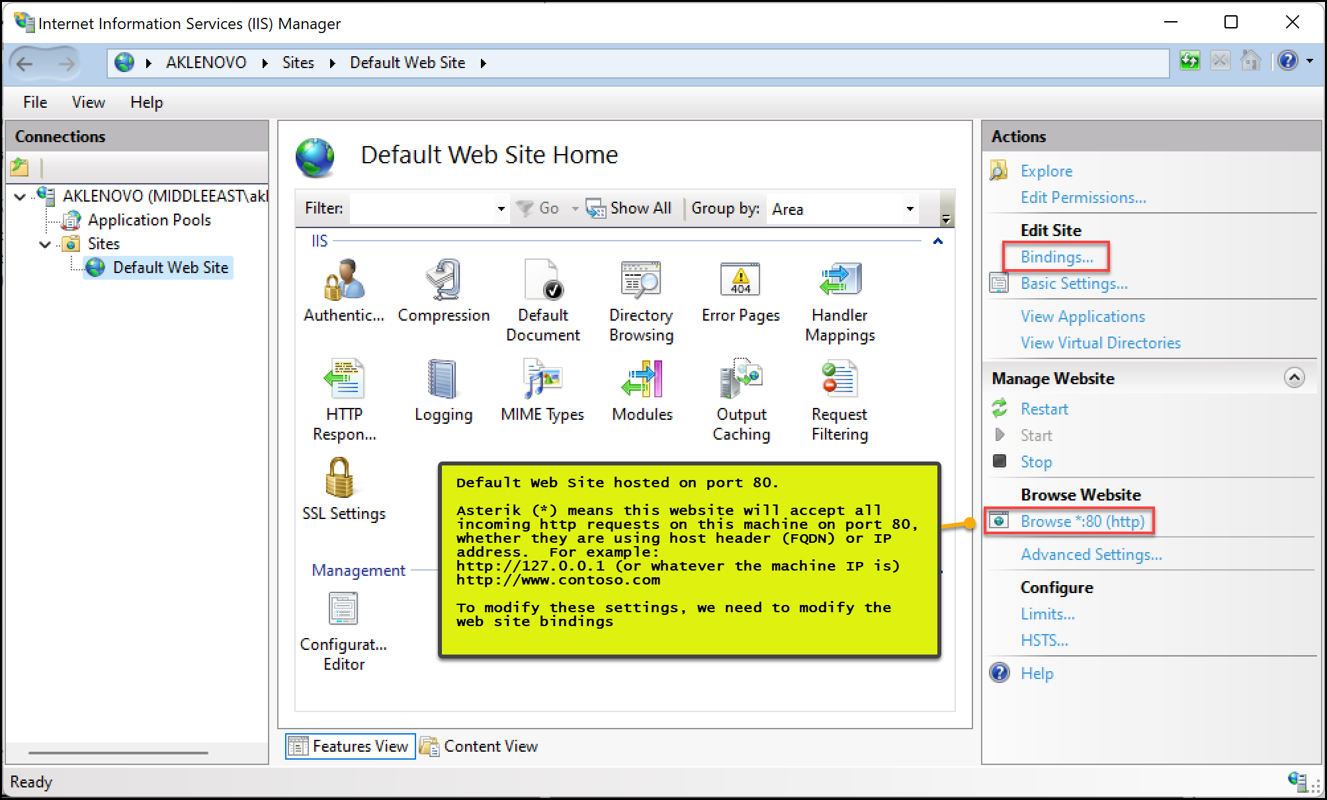

Slide 7
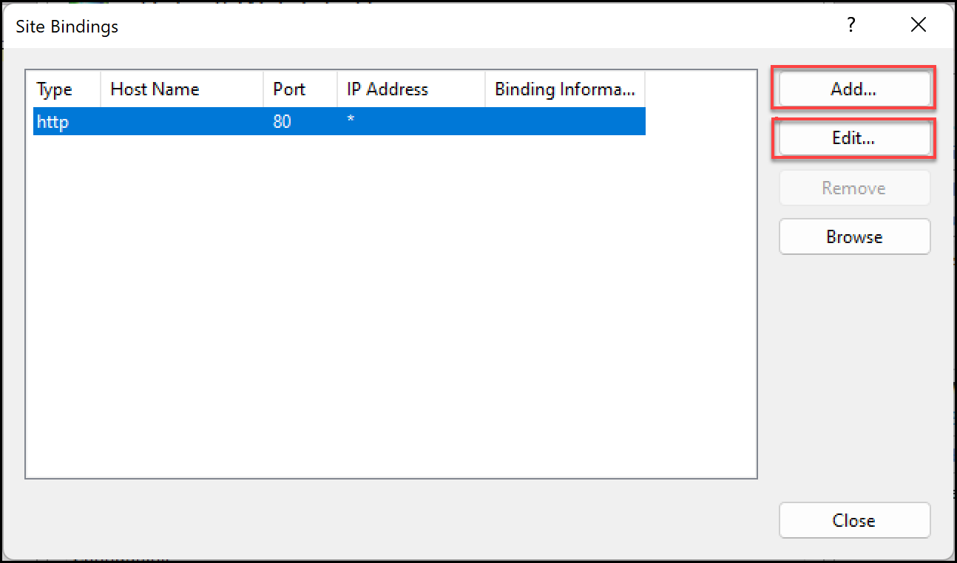
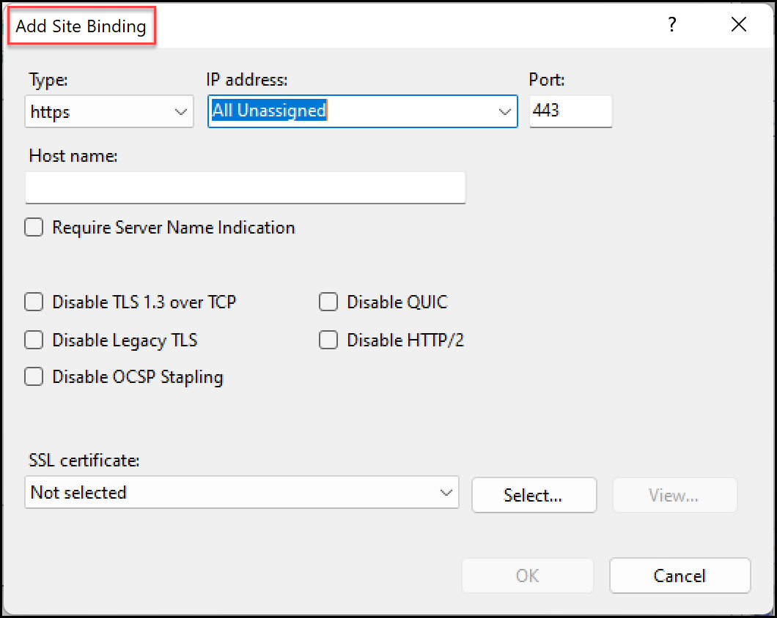
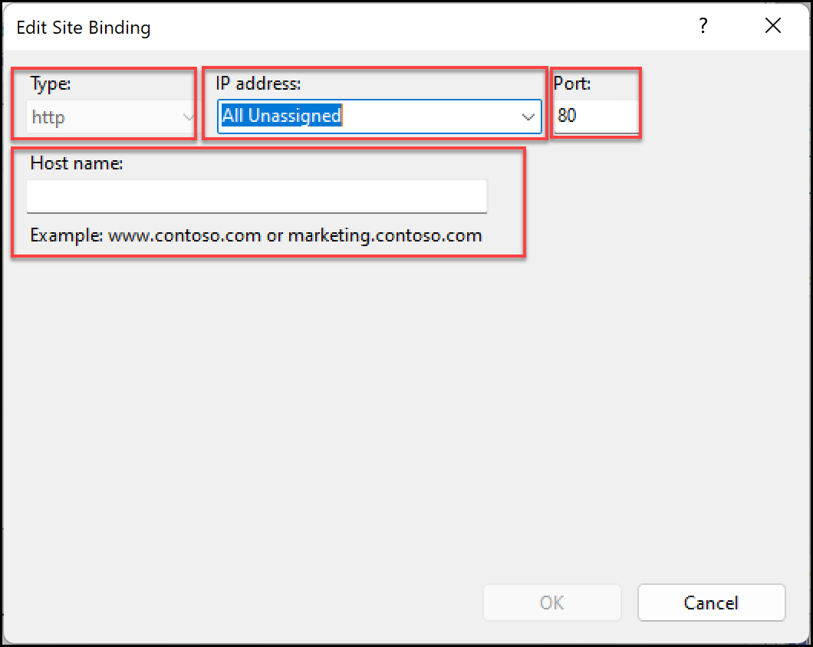
Once website is setup, add the required entries in windows hosts file (c:\windows\system32\drivers\etc\hosts) for local testing, or add a public DNS A record.
This process allows mapping of custom domain name to your website.
Notes:
How to Set Up SSL on IIS 7 or later | Microsoft Learn
How to Create and Bind a Self Signed Certificate in IIS 10 (msftwebcast.com)
What's the Hosts file
The Hosts file is used by the operating system to map human-friendly hostnames to numerical Internet Protocol (IP) addresses which identify and locate a host in an IP network. The hosts file is one of several system resources that address network nodes in a computer network and is a common part of an operating system's IP implementation. The Hosts file contains lines of text consisting of an IP address in the first text field followed by one or more host names. Each field is separated by white space (Tabs are often preferred for historical reasons, but spaces are also used). Comment lines may be included, and they are indicated by a hash character (#) in the first position of such lines. Entirely blank lines in the file are ignored.
How to reset the Hosts file back to the default - Microsoft Support

Slide 8

Configure Azure App Service Plans Introduction
Implement Azure App Service Plans
Determine App Service Plan Pricing
Scale Up and Scale Out the App Service Plan
Configure App Service Plan Scaling
Demonstration – Create an App Service Plan
Summary and Resources
Notes:
Deploy and manage Azure compute resources (20–25%)
Create and configure Azure App Service
* Create an App Service.
* Secure an App Service.
* Configure custom domain names.
* Configure backup for an App Service.
* Configure networking settings.
* Configure deployment settings.

Slide 9
Implement Azure App Service Plans
Define a set of compute resources for a web app to run
Determines performance, price, and features
One or more apps can be configured to run in the same App Service plan
Region where compute resources will be created
Number of virtual machine instances
Size of virtual machine instances
Pricing tier (next slide)
Notes:
Azure App Service plan overview - https://docs.microsoft.com/azure/app-service/overview-hosting-plans

Slide 10
Determine App Service Plan Pricing
Selected Features | Free | Shared (dev/test) | Basic (dedicated dev/test) | Standard (production workloads) | Premium (enhanced scale and performance) | Isolated (high-performance, security and isolation)
Web, mobile, or API apps | 10 | 100 | Unlimited | Unlimited | Unlimited | Unlimited
Disk space | 1 GB | 1 GB | 10 GB | 50 GB | 250 GB | 1 TB
Auto Scale | – | – | – | Supported | Supported | Supported
Deployment Slots | 0 | 0 | 0 | 5 | 20 | 20
Max Instances | – | – | Up to 3 | Up to 10 | Up to 30 | Up to 100
Shared compute (Free and Shared). Run apps on the same Azure VM as other App Service apps, and the resources cannot scale out
Dedicated compute (Basic, Standard, Premium). Run apps in the same plan in dedicated Azure VMs
Isolated. Runs apps on dedicated Azure VMs in dedicated Azure virtual networks
Notes:
App Service pricing - https://azure.microsoft.com/pricing/details/app-service/windows/

Slide 11
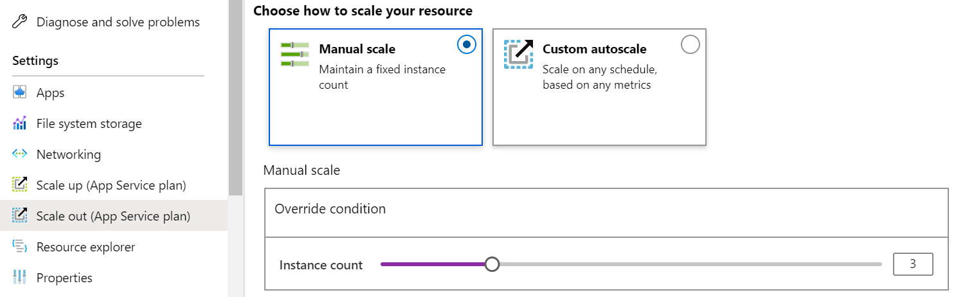
Scale Up and Scale Out the App Service Plan
Scale up (change the App Service plan):
More hardware (CPU, memory, disk)
More features (dedicated virtual machines, staging slots, autoscaling)
Scale out (increase the number of VM instances):
Manual (fixed number of instances)
Auto scale (based on predefined rules and schedules)
Notes:
Scale up an app in Azure App Service - https://docs.microsoft.com/azure/app-service/manage-scale-up

Slide 12
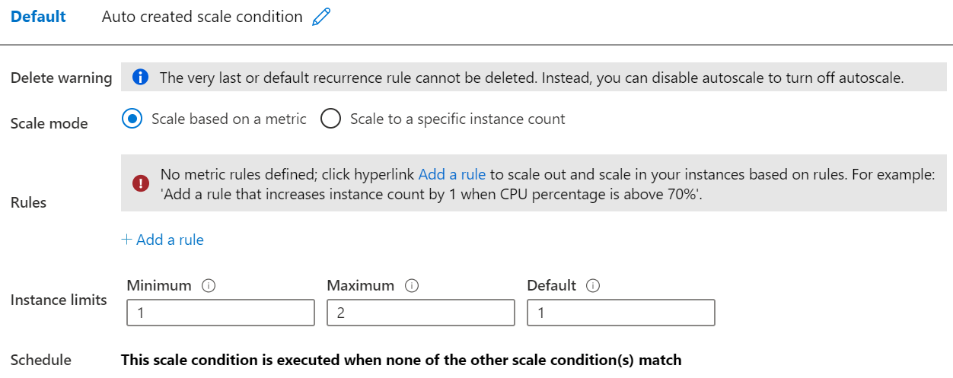
Configure App Service Plan Scaling
Adjust available resources based on the current demand
Improves availability and fault tolerance
Scale based on a metric (CPU percentage, memory percentage, HTTP requests)
Scale according to a schedule (weekdays, weekends, times, holidays)
Can implement multiple rules – combine metrics and schedules
Don’t forget to scale in
Notes:
Get started with Autoscale in Azure - https://docs.microsoft.com/azure/app-service/manage-scale-up
?toc=/azure/app-service/toc.json

Slide 13

Demonstration – Create an App Service plan
Create an App Service Plan in the Azure Portal
Review Pricing Tiers
Configure Autoscaling
Notes:
✔ Always consider having students walk-through the demonstrations themselves. Also, consider the overlap with the formal labs and your best use of time.

Slide 14
Summary and Resources – Configure Azure App Service Plans
Knowledge Check Questions
Microsoft Learn Modules (docs.microsoft.com/Learn)
Scale an App Service web app to efficiently meet demand with App Service scale up and scale out
Notes:
Learn - https://docs.microsoft.com/learn/browse
The Assessment Guide in the MCT DLC has open-ended questions.
What is an App Service Plan and what will you consider in deciding which plan to choose?
Answer: An App Service Plan defines a set of compute resources for a web app to run. The plan determines performance, price, and features for a web app. Considerations for which plan to choose include how many web apps you can have, the disk space available to the web apps, if the web app can autoscale, how many deployment slots are available, and how many web app instances can be created.

Slide 15
Configure Azure App Services

Slide 16



Configure Azure App Services Introduction
Implement Azure App Service
Create an App Service
Create Deployment Slots
Add Deployment Slots
Secure an App Service
Create Custom Domain Names
Backup an App Service
Demonstration – Create an App Service
Summary and Resources
Notes:
Deploy and manage Azure compute resources (25-30%)
Create and configure Web Apps
Create and configure App Service
Create and configure App Service Plans

Slide 17
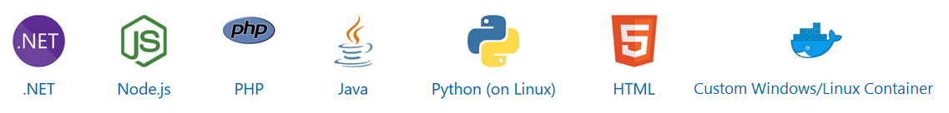
Implement Azure App Service
Includes Web Apps, API Apps, Mobile Apps, and Function Apps
Fully managed environment enabling high productivity development
Platform-as-a-service (PaaS) offering for building and deploying highly available cloud apps for web and mobile
Platform handles infrastructure so developers focus on core web apps and services
Developer productivity using .NET, .NET Core, Java, Python and a host of others
Provides enterprise-grade security and compliance
Notes:
App Service - https://azure.microsoft.com/services/app-service/

Slide 18
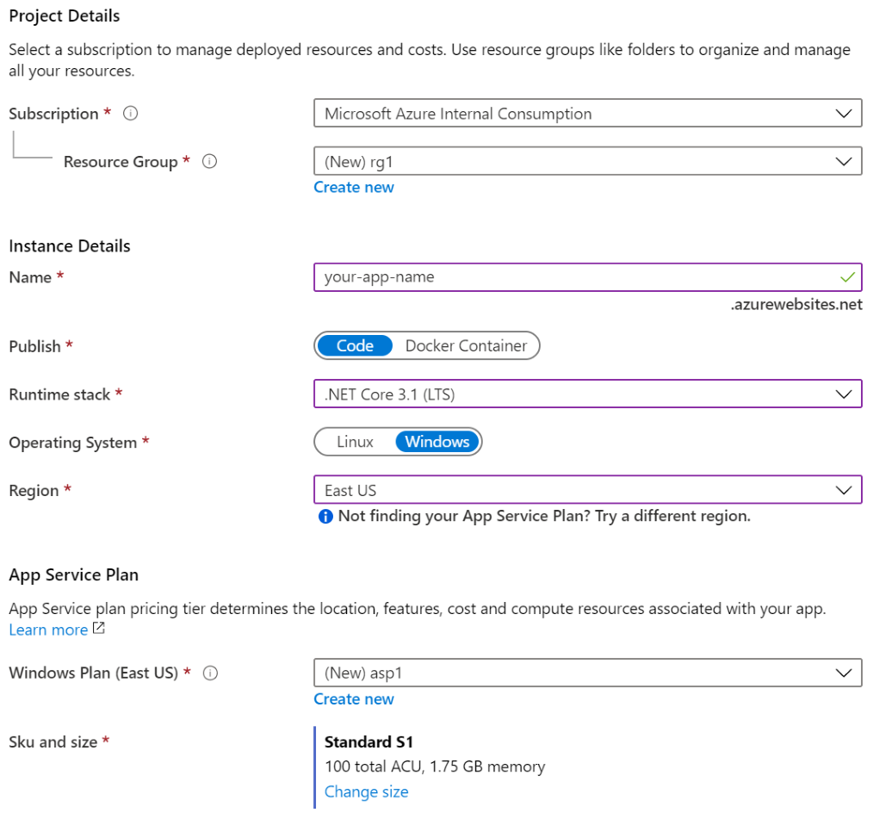
Create an App Service
Name must be unique
Access using azurewebsites.net – can map to a custom domain
Publish Code (Runtime Stack)
Publish Docker Container
Linux or Windows
Region closest to your users
App Service Plan
Notes:
Manage an App Service plan in Azure - https://docs.microsoft.com/azure/app-service/app-service-plan-manage

Slide 19



Create Deployment Slots
Service Plan | Slots
Free, Shared, Basic | 0
Standard | Up to 5
Premium | Up to 20
Isolated | Up to 20
Continuous Deployment with Stage Slot
Developer 1
GitHub
Swap
Staging
Production
Developer 2
Deploy to a different deployment slots (depends on service plan)
Validate changes before sending to production
Deployment slots are live apps with their own hostnames
Avoids a cold start – eliminates downtime
Fallback to a last known good site
Auto Swap when pre-swap validation is not needed
Notes:
Set up staging environments - https://docs.microsoft.com/azure/app-service/web-sites-staged-publishing?toc=%2Fazure%2Fapp-service%2Ftoc.json#add-a-deployment-slot
App Service Web App – block web access to non-production deployment slots - http://ruslany.net/2014/04/azure-web-sites-block-web-access-to-non-production-deployment-slots/
✔ Each App Service plan mode supports a different number of deployment slots. To find out the number of slots your app’s mode supports, see App Service Limits.

Slide 20
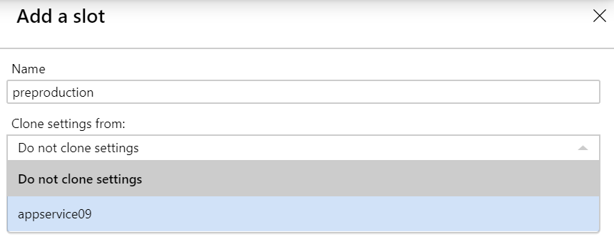
Add Deployment Slots
Select whether to clone an app configuration from another deployment slot
When you clone, pay attention to the settings:
Slot-specific app settings and connection strings
Continuous deployment settings
App Service authentication settings
Not all settings are sticky (endpoints, custom domain names, SSL certificates, scaling)
Review and edit your settings before swapping
Notes:
✔ You can configure app settings and connections to stick to a slot and not be swapped. This done in the App Settings blade. A developer can create new settings for the web app.

Slide 21
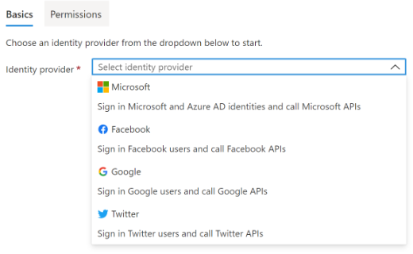
Secure an App Service
Authentication:
Enable authentication – default anonymous
Log in with a third-party identity provider
Security:
Troubleshoot with Diagnostic Logs – failed requests, app logging
Add an SSL certificate – HTTPS
Define a priority ordered allow/deny list to control network access to the app
Store secrets in the Azure Key Vault
Notes:
Security recommendations for App Service - https://docs.microsoft.com/azure/app-service/security-recommendations

Slide 22
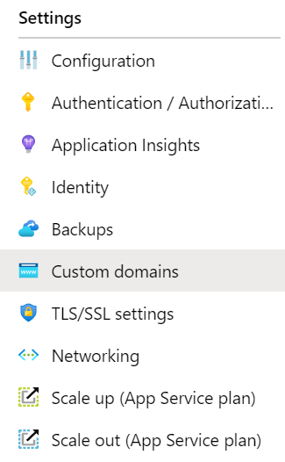
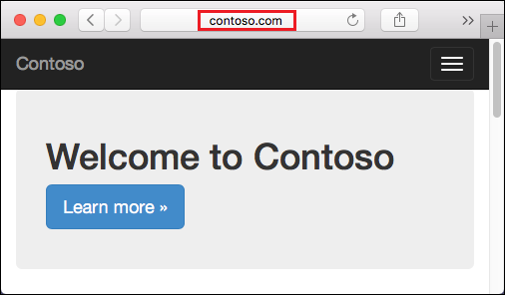
Create Custom Domain Names
Redirect the default web app URL
Validate the custom domain in Azure
Use the DNS registry for your domain provider – create a CNAME or A record with the mapping
Ensure App Service plan supports custom domains

Slide 23
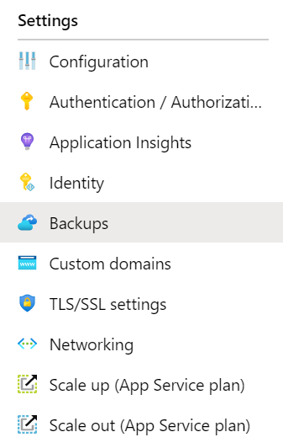
Backup an App Service
Create app backups manually or on a schedule
Backup the configuration, file content, and database connected to the app
Requires Standard or Premium plan
Backups can be up to 10 GB of app and database content
Configure partial backups and exclude items from the backup
Restore your app on-demand to a previous state, or create a new app
Notes:
Back up your App in Azure - https://docs.microsoft.com/azure/app-service/web-sites-backup
Configure partial backups - https://docs.microsoft.com/azure/app-service/web-sites-backup

Slide 24

Demonstration – Create an App Service
Create a Web App in the Azure Portal
Test the Web App
Configure Deployment Slots
Configure Backup
Notes:
✔ Always consider having students walk-through the demonstrations themselves. Also, consider the overlap with the formal labs and your best use of time.

Slide 25
Summary and Resources – Configure Azure App Services
Knowledge Check Questions
Microsoft Learn Modules (docs.microsoft.com/Learn)
Host a web application with Azure App Service (Sandbox)
Stage a web app deployment for testing and rollback by using App Service deployment slots
Dynamically meet changing web app performance requirements with autoscale rules
A sandbox indicates a hands-on exercise.
Notes:
Learn - https://docs.microsoft.com/learn/browse
The Assessment Guide in the MCT DLC has open-ended questions.
List at least three administrator tasks for an organization’s web app.
If you are administering an Azure web app you will need to monitor, secure, and backup the app. Monitoring includes usage stats, outages, page views, user sessions, performance, and troubleshooting. Securing tasks include access, authentication, certificates, and identity. Backup decisions make sure all parts of the app can be restored, as well as frequency of the backups. Creating a custom domain name is another important task; there are certainly other important tasks.

Slide 26
Lab 09a - Implement Web Apps

Slide 27
Lab 09a – Implement web apps
Lab scenario
You need to evaluate the use of Azure Web apps for hosting Contoso’s web sites, hosted currently in the company’s on-premises data centers. The web sites are running on Windows servers using PHP runtime stack. You also need to determine how you can implement DevOps practices by leveraging Azure web apps deployment slots
Objectives
Task 1: Create an Azure web app
Task 2: Create a staging deployment slot
Task 3: Configure web app deployment settings
Task 4: Deploy code to the staging deployment slot
Task 5: Swap the staging slots
Task 6: Configure and test autoscaling of the Azure web app
Next slide for an architecture diagram
Notes:
LAB 09a - Implement Web Apps - ESTIMATED DURATION 30 MIN
Lab Repository - https://microsoftlearning.github.io/AZ-104-MicrosoftAzureAdministrator/

Slide 28






Lab 09a – Architecture diagram
Task 1
az104-09a-rg1
AppService
AppServiceplan
Production slot
Task 6
Task 5
Swap the staging slot
Autoscale rule
Task 2
Staging slot
Task 4
Task 3
php-docs-hello-world
code
Local git
php-docs-hello-world
code

Slide 29

End of presentation

Slide 30


Explore Continuous Integration and Deployment
Work in a single source control
Continuous Deployment
Whenever code updates are pushed to the source control, then the website or web app will automatically pick up the updates
Developer 1
GitHub
A continuous deployment workflow publishes the most recent updates from a project
Website
Or similar single source control
Use the portal for continuous deployments from GitHub, Bitbucket, or Azure DevOps
Developer 2
Notes:
Continuous deployment - https://github.com/projectkudu/kudu/wiki/Continuous-deployment#setting-up-continuous-deployment-using-manual-steps

Slide 31
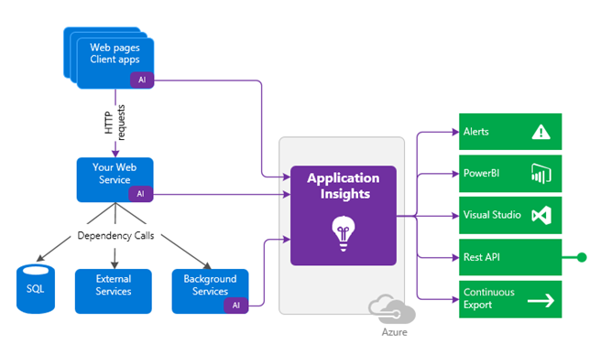
Use Application Insights
Request rates, deny rates, response time and failure rates
Page views and load performance
User and session counts
Performance counters
Diagnostics and Exceptions
Notes:
What is Application Insights? - https://docs.microsoft.com/azure/azure-monitor/app/app-insights-overview

Slide 32
Compare Containers to Virtual Machines (replaced)
Feature | Containers | Virtual Machines
Isolation | Typically provides lightweight isolation from the host and other containers but doesn’t provide as strong a security boundary as a virtual machine | Provides complete isolation from the host operating system and other VMs. This is useful when a strong security boundary is critical, such as hosting apps from competing companies on the same server or cluster
Operating system | Runs the user mode portion of an operating system and can be tailored to contain just the needed services for your app, using fewer system resources. | Runs a complete operating system including the kernel, thus requiring more system resources (CPU, memory, and storage)
Deployment | Deploy individual containers by using Docker via command line; deploy multiple containers by using an orchestrator such as Azure Kubernetes Service | Deploy individual VMs by using Windows Admin Center or Hyper-V Manager; deploy multiple VMs by using PowerShell or System Center Virtual Machine Manager
Persistent storage | Use Azure Disks for local storage for a single node, or Azure Files (SMB shares) for storage shared by multiple nodes or servers | Use a virtual hard disk (VHD) for local storage for a single VM, or an SMB file share for storage shared by multiple servers
Fault tolerance | If a cluster node fails, any containers running on it are rapidly recreated by the orchestrator on another cluster node | VMs can fail over to another server in a cluster, with the VM’s operating system restarting on the new server
Notes:
Containers vs. virtual machines - https://docs.microsoft.com/virtualization/windowscontainers/about/containers-vs-

